Slide 1
The Great Jehovah
“Sing to the Lord, all the earth”
Psalm 96
Notes:
Psalm 96 (READ)
Ingratitude is a sin that often affects mankind.
(Romans 1:21), “because, although they knew God, they did not glorify Him as God, nor were thankful, but became futile in their thoughts, and their foolish hearts were darkened.”
God is great, and is worthy of our thanksgiving and praise!

Slide 2
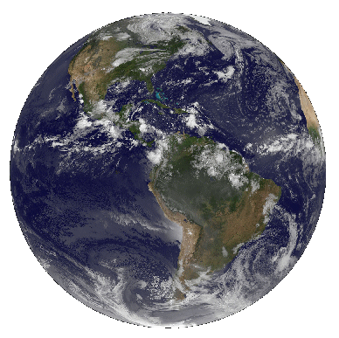
We Give Thanks to God
In Song (1; 33:1-3)
Notes:
(1-2), “Oh, sing to the Lord a new song! Sing to the Lord, all the earth. ² Sing to the Lord, bless His name; Proclaim the good news of His salvation from day to day.”
New song indicates new in quality!
i.e. – A song from the upright fresh from the singer’s heart
(Psalm 133:1-3), “Rejoice in the Lord, O you righteous! For praise from the upright is beautiful. ² Praise the Lord with the harp; Make melody to Him with an instrument of ten strings. ³ Sing to Him a new song; Play skillfully with a shout of joy.”
Giving thanks comes from a heart that knows and acknowledges its blessings; God expects our singing to be from a thankful heart.

Slide 3
We Give Thanks to God
In Song (1; 33:1-3)
For His character and Blessings (2-9; 29:2-3; 104:1-4)
Notes:
(2-5) Thanks for God’s Power (READ)
(Psalm 29:2), “Give unto the Lord the glory due to His name; Worship the Lord in the beauty of holiness. 3 The voice of the Lord is over the waters; The God of glory thunders; The Lord is over many waters.”
God is due honor because of who He is, what He has done and what he will do.
(6-9) Thanks for God’s Dignity (READ)
(Psalm 104:1-5), “Bless the Lord, O my soul! O Lord my God, You are very great: You are clothed with honor and majesty, ² Who cover Yourself with light as with a garment, Who stretch out the heavens like a curtain. ³ He lays the beams of His upper chambers in the waters, Who makes the clouds His chariot, Who walks on the wings of the wind, ⁴ Who makes His angels spirits, His ministers a flame of fire. ⁵ You who laid the foundations of the earth, So that it should not be moved forever”
Our worship must be reflective of God’s honor, majesty, strength and beauty. How are we (you) doing?
Isn’t this an indication of the inappropriate nature of the casual and flippant efforts characteristic of our day?

Slide 4
We Give Thanks to God
In Song (1; 33:1-3)
For His character and Blessings (2-9; 29:2-3; 104:1-4)
For his Judgments (10-13) (Romans 2:1-11)
Notes:
(10-13) READ
God’s judgments are righteous (“with equity”, ASV) No preference, capriciousness, partiality
We are thankful that truth is a consistent, objective standard.
(Romans 2:1-11) READ

Slide 5
Compared to the singer of Psalm 96,
We share in far greater blessings
in Christ: Our thanksgiving
ought to abound more and more!
Notes:
(Colossians 2:6-7), “As you therefore have received Christ Jesus the Lord, so walk in Him, ⁷ rooted and built up in Him and established in the faith, as you have been taught, abounding in it with thanksgiving.”

Slide 6
The Righteous Judgment of God
He will “render to each one according to his deeds”
(Romans 2:6)
Notes:
This slide used for an invitation.

